Slide 1

GAME PROGRAMMING IN C++
2020

Slide 2

Šta vi očekujete od ovog kursa?

Slide 4
Kako?
Pravićemo video igre „od nule“
U timovima
Koristićemo C++ i spoljne biblioteke
U Windowsu
Nije potrebno prethodno znanje grafike ili rada u Windowsu
Notes:
You should have a working knowledge
of basic object-oriented programming concepts and at least some experience
programming in C++.

Slide 5
Programiranje ≠ Razvoj igara
90ih su programeri bili apsolutno dominantni u industriji
Danas su timovi mnogo veći i specijalizovaniji
Sad postoje alati koji omogućavaju pravljenje igara bez ikakvog znanja programiranja
Postoje pozicije u timovima koje programiraju, ali nisu programeri
Technical artist
Technical game designer

Slide 6
Tipovi programera
Gameplay
AI
Online
Networking
Engine
Graphics
Physics
Sound
UI
3C
Tools

Slide 7
Specifičnosti programiranja video igara
Cool
Dress code
Umetnost koliko i tehnologija
Direktan feedback
Nove igračke*
Najnovije tehnologije*
Crunch
Prilično težak posao
Javni rokovi
Direktan feedback
Kako se programira zabava?

Slide 8
Programerski alati
Engleski jezik
Version control (Perforce, SVN, git)
Programski jezik (C++, Lua, C#, Python)
Compiler + Linker (MSVC, Clang, GCC)
IDE (Visual Studio, PyCharm, Eclipse, vim)
Profiling tools (CPU, GPU, Memory)
Code analysis (clang-tidy, Coverity, UBSAN, ASAN, C++ Lifetime Profile)
CI/CD
Task management (Jira, Trello)

Slide 9
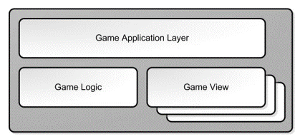
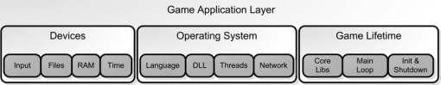
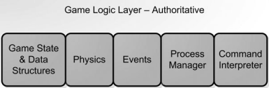
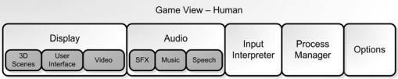
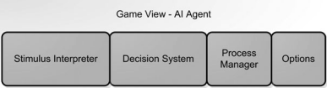
Arhitektura video igre
Mike McShaffry and David Graham. 2012. Game Coding Complete (4th. ed.).

Slide 10
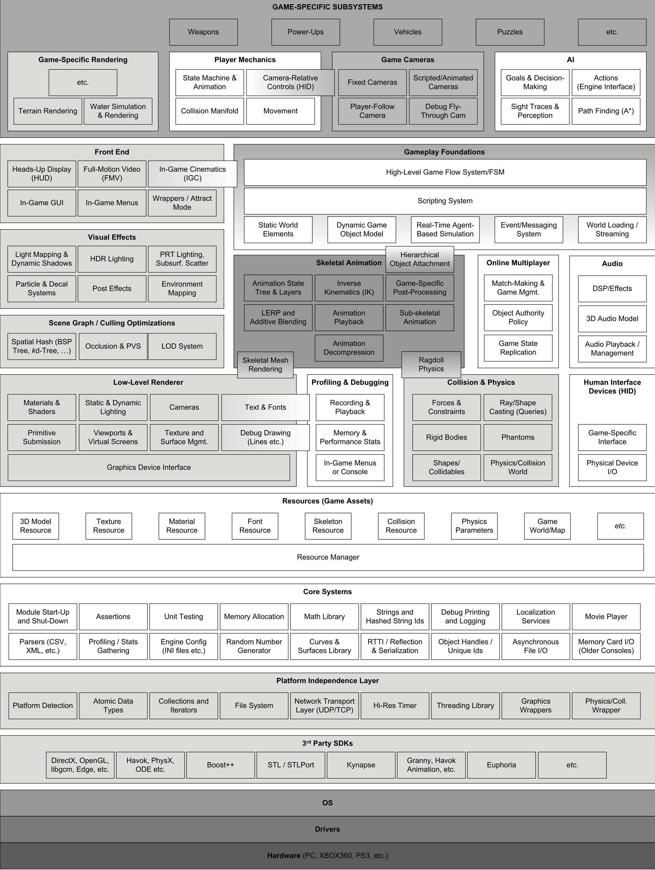

Jason Gregory. 2014. Game Engine Architecture
Notes:
The line between a game and its engine is often blurry. Some engines make
a reasonably clear distinction, while others make almost no attempt to sepa-
rate the two. In one game, the rendering code might “know” specifi cally how
to draw an orc. In another game, the rendering engine might provide general-
purpose material and shading facilities, and “orc-ness” might be defi ned en-
tirely in data. No studio makes a perfectly clear separation between the game
and the engine, which is understandable considering that the defi nitions of
these two components often shift as the game’s design solidifi es.
Arguably a data-driven architecture is what differentiates a game engine
from a piece of software that is a game but not an engine. When a game
contains hard-coded logic or game rules, or employs special-case code to ren-
der specifi c types of game objects, it becomes diffi cult or impossible to reuse
that software to make a different game. We should probably reserve the term
“game engine” for software that is extensible and can be used as the founda-
tion for many different games without major modifi cation.

Slide 11
Engine
Jason Gregory. 2014. Game Engine Architecture
Notes:
Game engines are typically somewhat genre specifi c. An engine designed for
a two-person fi ghting game in a boxing ring will be very different from a mas-
sively multiplayer online game (MMOG) engine or a fi rst-person shooter (FPS)
engine or a real-time strategy (RTS) engine. However, there is also a great deal
of overlap—all 3D games, regardless of genre, require some form of low-level
user input from the joypad, keyboard and/or mouse, some form of 3D mesh
rendering, some form of heads-up display (HUD) including text rendering in
a variety of fonts, a powerful audio system, and the list goes on. So while
the Unreal Engine, for example, was designed for fi rst-person shooter games,
it has been used successfully to construct games in a number of other genres
as well, including the wildly popular third-person shooter franchise Gears of
War by Epic Games, the hit action-adventure games in the Batman: Arkham se-
ries by Rocksteady Studios, the well-known fi ghting game Tekken 7 by Bandai
Namco Studios, and the fi rst three role-playing third-person shooter games in
the Mass Effect series by BioWare.
Let’s take a look at some of the most common game genres and explore
some examples of the technology requirements particular to each.
First-Person Shooters (FPS)
First-person games are typically some of the most technologically challeng-
ing to build.
• effi cient rendering of large 3D virtual worlds;
• a responsive camera control/aiming mechanic;
• high-fi delity animations of the player’s virtual arms and weapons;
• a forgiving player character motion and collision model, which often
gives these games a “fl oaty” feel;
• high-fi delity animations and artifi cial intelligence for the non-player
characters (NPCs)—the player’s enemies and allies;
Platformers and Other Third-Person Games
Third-person character-based games have a lot in common with fi rst-per-
son shooters, but a great deal more emphasis is placed on the main character’s
abilities and locomotion modes. In addition, high-fi delity full-body charac-
ter animations are required for the player’s avatar, as opposed to the some-
what less-taxing animation requirements of the “fl oating arms” in a typical
FPS game.
• moving platforms, ladders, ropes, trellises and other interesting locomo-
tion modes;
• puzzle-like environmental elements;
• a third-person “follow camera” which stays focused on the player char-
acter and whose rotation is typically controlled by the human player via
the right joypad stick (on a console) or the mouse (on a PC—note that
while there are a number of popular third-person shooters on a PC, the
platformer genre exists almost exclusively on consoles); and
• a complex camera collision system for ensuring that the view point never
“clips” through background geometry or dynamic foreground objects.
Fighting Games
• a rich set of fi ghting animations;
• accurate hit detection;
• a user input system capable of detecting complex button and joystick
combinations; and
• crowds, but otherwise relatively static backgrounds.
• physics-based cloth and hair simulations for the characters.
Strategy Games
• Each unit is relatively low-res, so that the game can support large num-
bers of them on-screen at once.
• Orthographic of Perspective camera
• Mouse-based input with a focus on toolbars and menus
MMORPG
At the heart of all MMOGs is a very powerful battery of servers. These
servers maintain the authoritative state of the game world, manage users sign-
ing in and out of the game, provide inter-user chat or voice-over-IP (VoIP) ser-
vices and more. Graphics fi delity in an MMO is almost always lower than its non-massively
multiplayer counterparts, as a result of the huge world sizes and extremely
large numbers of users supported by these kinds of games.
VR/AR/MR
• Stereoscopic rendering. A VR game needs to render the scene twice, once
for each eye. This doubles the number of graphics primitives that must
be rendered, although other aspects of the graphics pipeline such as vis-
ibility culling can be performed only once per frame, since the eyes are
reasonably close together. As such, a VR game isn’t quite as expensive to
render as the same game would be to render in split-screen multiplayer
mode, but the principle of rendering each frame twice from two (slightly)
different virtual cameras is the same.
• Very high frame rate.
• Navigation issues. In an FPS game, the player can simply walk around
the game world with the joypad or the WASD keys. In a VR game, a
small amount of movement can be realized by the user physically walk-
ing around in the real world

Slide 12
Jason Gregory. 2014. Game Engine Architecture

Slide 13
Gameplay
Jason Gregory. 2014. Game Engine Architecture
Notes:
A game is defined not by its technology but by its gameplay. Gameplay
can be defined as the overall experience of playing a game. The term game
mechanics pins down this idea a bit more concretely—it is usually defined as
the set of rules that govern the interactions between the various entities in the
game.
Gameplay designs vary widely from genre to genre and from game to game.
In the early days of game development, games were largely hard-coded by
programmers. the amount of game content is growing faster than team size.
Engineering resources are often a production bottleneck because high quality
engineering talent is limited and expensive and because engineers tend
to produce content much more slowly than artists and game designers (due to
the complexities inherent in computer programming). Most teams now believe
that it’s a good idea to put at least some of the power to create content
directly into the hands of the folks responsible for producing that content—
namely the designers and the artists. Data-driven architectures can improve team efficiency by fully leveraging
all staff members to their fullest potential and by taking some of the heat off
the engineering team.

Slide 14
Jason Gregory. 2014. Game Engine Architecture

Slide 15
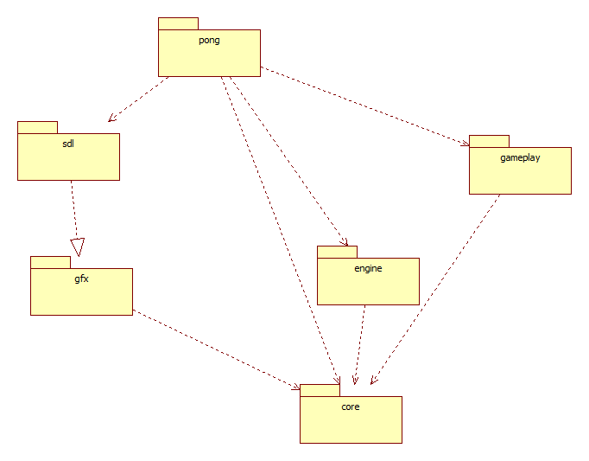

Slide 16


Arhitektura naše igre

Slide 17
Razvoj u Windowsu
Visual Studio 2019
git
Organizacija projekta

Slide 18
Organizacija projekta
Pitchfork - https://github.com/vector-of-bool/pitchfork
engine/
src/
system1/
system2/
extern/
lib1/
lib2/
game/
src/
system1/
system2/
build/ & temp/
Not managed by git, results of the build process go here

Slide 19
git
Git for Windows: https://gitforwindows.org/
http://gitignore.io/
GitHub / GitLab
Initial commit

Slide 20


Visual Studio
Creating a new project & solution
Console application
Windows desktop application
Engine
Ime biblioteke
Putanja na disku
Ime igre

Slide 21
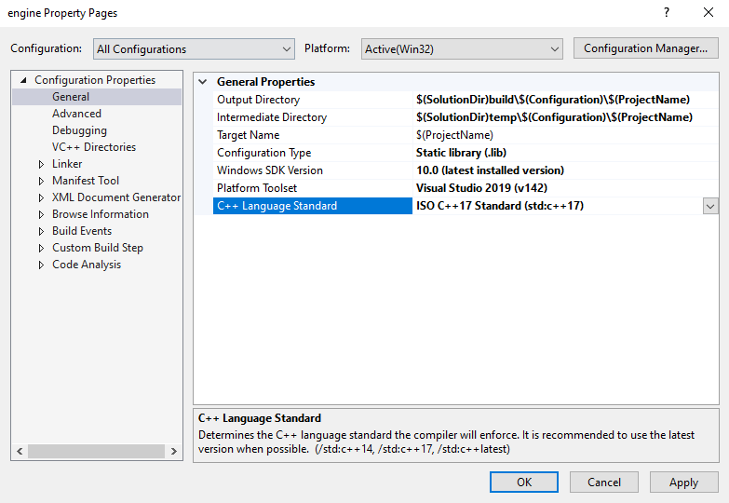
Visual Studio
All Configurations
Debug
Release
???
Platform
Win32
x64
🎮
Configuration Type
Executable
Static library
Dynamic library

Slide 22
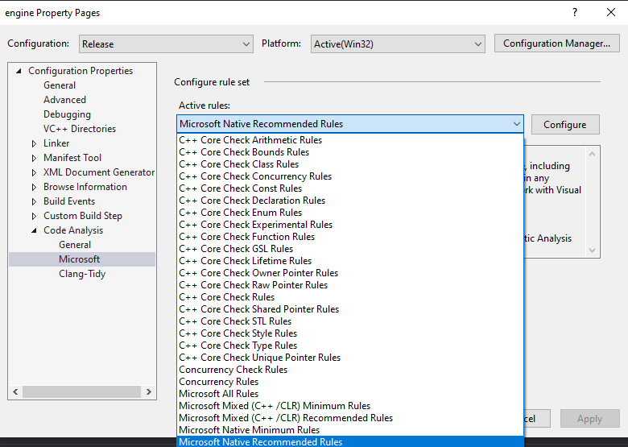
Visual Studio
Nije obavezno
Ne mora stalno
Poboljšava kvalitet života
Code Analysis
Microsoft Rules
Clang-Tidy

Slide 23
Coding Style
Klase u Pascal Case: MyClass
Funkcije i varijable u camelCase: myMethod
Konstante u allcaps: const double PI=3.14159265358979323
Atributi/članovi klase imaju prefiks m_: m_width
Argumenti funkcija imaju sufiks: _: width_
Svaki blok koda mora biti između { }
Trudimo se da sve što može bude const
Koristimo auto kad ima smisla
Konzistentnost je najbitnija

Slide 24
main
Entry point u program
main vs wmain vs WinMain vs wWinMain
int main () { ... }
int main (int argc, char *argv[]) { ... }
Domaći zadatak: CppCon 2018: Matt Godbolt “The Bits Between the Bits: How We Get to main()” https://youtu.be/dOfucXtyEsU
Notes:
The main function is called at program startup after initialization of the non-local objects with static storage duration. It is the designated entry point to a program that is executed in hosted environment (that is, with an operating system). The entry points to freestanding programs (boot loaders, OS kernels, etc) are implementation-defined.

Slide 25
Na sledećem času
Pravimo Logger
Pravimo Application Layer, razdvajamo Engine i Game
Notes:
The main function is called at program startup after initialization of the non-local objects with static storage duration. It is the designated entry point to a program that is executed in hosted environment (that is, with an operating system). The entry points to freestanding programs (boot loaders, OS kernels, etc) are implementation-defined.

